Slide 1
UX Research &Design
by Ahmed Gamal

Slide 2
Why UX?

Slide 3
Is good UI enough?
Why UX?
NO!

Slide 4

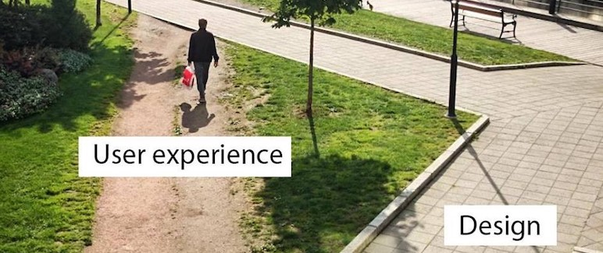
Is good UI enough?
NO!

Slide 5
Is good UI enough?
NO!

Slide 7
What is UX ?

Slide 8
, a cognitive scientist and co-founder of the Nielsen Norman Group Design Consultancy, is credited with coining the term “user experience” in the late 1990s. Here’s how he describes it as:
What is UX ?
Don Norman
“User experience encompasses all aspects of the end-user’s interaction with the company, its services, and its products.”

Slide 9
, a cognitive scientist and co-founder of the Nielsen Norman Group Design Consultancy, is credited with coining the term “user experience” in the late 1990s. Here’s how he describes it as:
Don Norman
“User experience encompasses all aspects of the end-user’s interaction with the company, its services, and its products.”
– Don Norman, Cognitive Scientist & User Experience Architect

Slide 10
, a cognitive scientist and co-founder of the Nielsen Norman Group Design Consultancy, is credited with coining the term “user experience” in the late 1990s. Here’s how he describes it as:
Don Norman
A UX designer thinks about how the experience makes the user feel, and how easy it is for the user to accomplish their desired tasks. They also observe and conduct task analyses to see how users actually complete tasks in a user flow.
“User experience encompasses all aspects of the end-user’s interaction with the company, its services, and its products.”
– Don Norman, Cognitive Scientist & User Experience Architect

Slide 11
A UX designer thinks about how the experience makes the user feel, and how easy it is for the user to accomplish their desired tasks. They also observe and conduct task analyses to see how users actually complete tasks in a user flow.
Don Norman
, a cognitive scientist and co-founder of the Nielsen Norman Group Design Consultancy, is credited with coining the term “user experience” in the late 1990s. Here’s how he describes it as:
“User experience encompasses all aspects of the end-user’s interaction with the company, its services, and its products.”
– Don Norman, Cognitive Scientist & User Experience Architect

Slide 12
But what makes great ?
UX

Slide 13
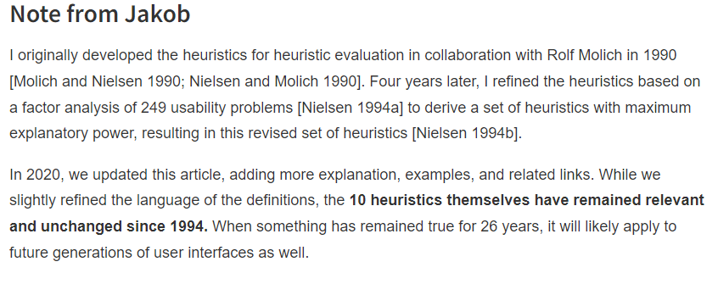
The 10 Usability Heuristics of Jakob Nielsen's

Slide 14
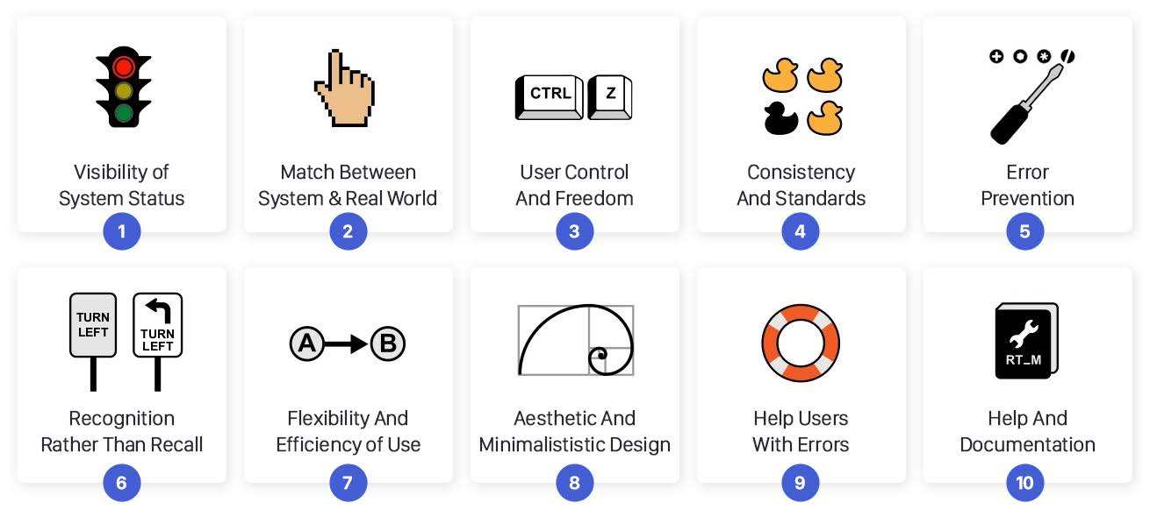
The 10 Usability Heuristics of Jakob Nielsen's

Slide 15
The 10 Usability Heuristics of Jakob Nielsen's

Slide 16
The 10 Usability Heuristics of Jakob Nielsen's

Slide 17
The 10 Usability Heuristics of Jakob Nielsen's

Slide 18
The 10 Usability Heuristics of Jakob Nielsen's

Slide 19
The 10 Usability Heuristics of Jakob Nielsen's

Slide 20
The 10 Usability Heuristics of Jakob Nielsen's

Slide 21
The 10 Usability Heuristics of Jakob Nielsen's

Slide 22
The 10 Usability Heuristics of Jakob Nielsen's

Slide 23
The 10 Usability Heuristics of Jakob Nielsen's

Slide 24
The 10 Usability Heuristics of Jakob Nielsen's

Slide 25
What is ?
UX research

Slide 26
What is ?
UX research
Quantitative
Qualitative

Slide 27
UX research
Quantitative
Qualitative
A quantitative study is a method to collect data from a large number of users through surveys or other tools, and the results are usually numerical. We use it to quantify a problem and understand how prevalent it is
A Qualitative study is to understand people’s beliefs, experiences, attitudes, behavior, and interactions. It generates non-numerical data.

Slide 28
A/B Testing
Common methods to conduct quantitative research
Surveys
Card Sorting

Slide 29
Focus Groups
Common methods to conduct qualitative research
Personal Interviews
Observations

Slide 30
Let's Play !

Slide 31
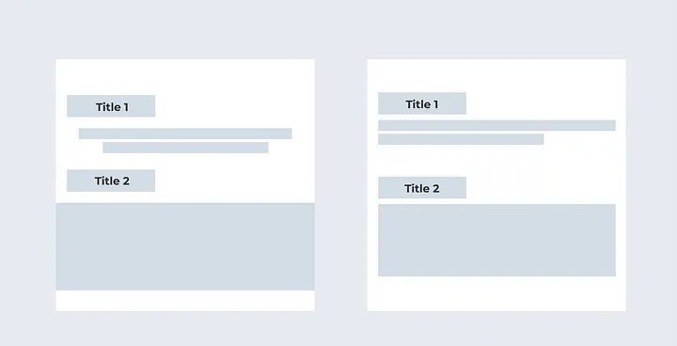
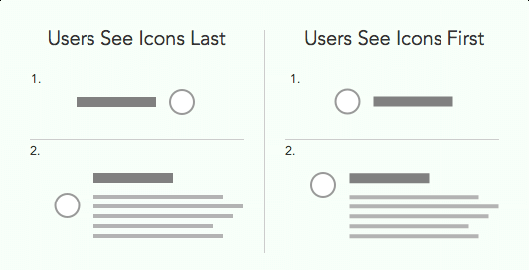
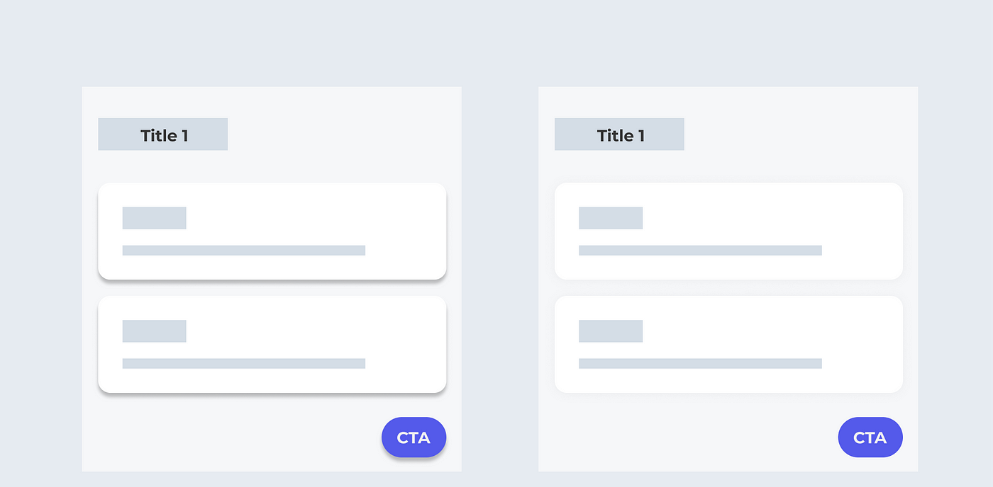
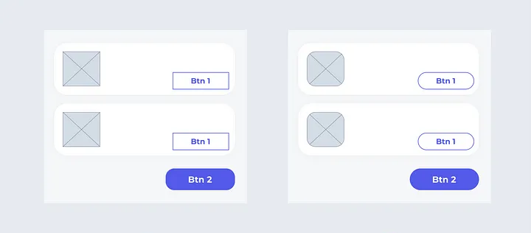
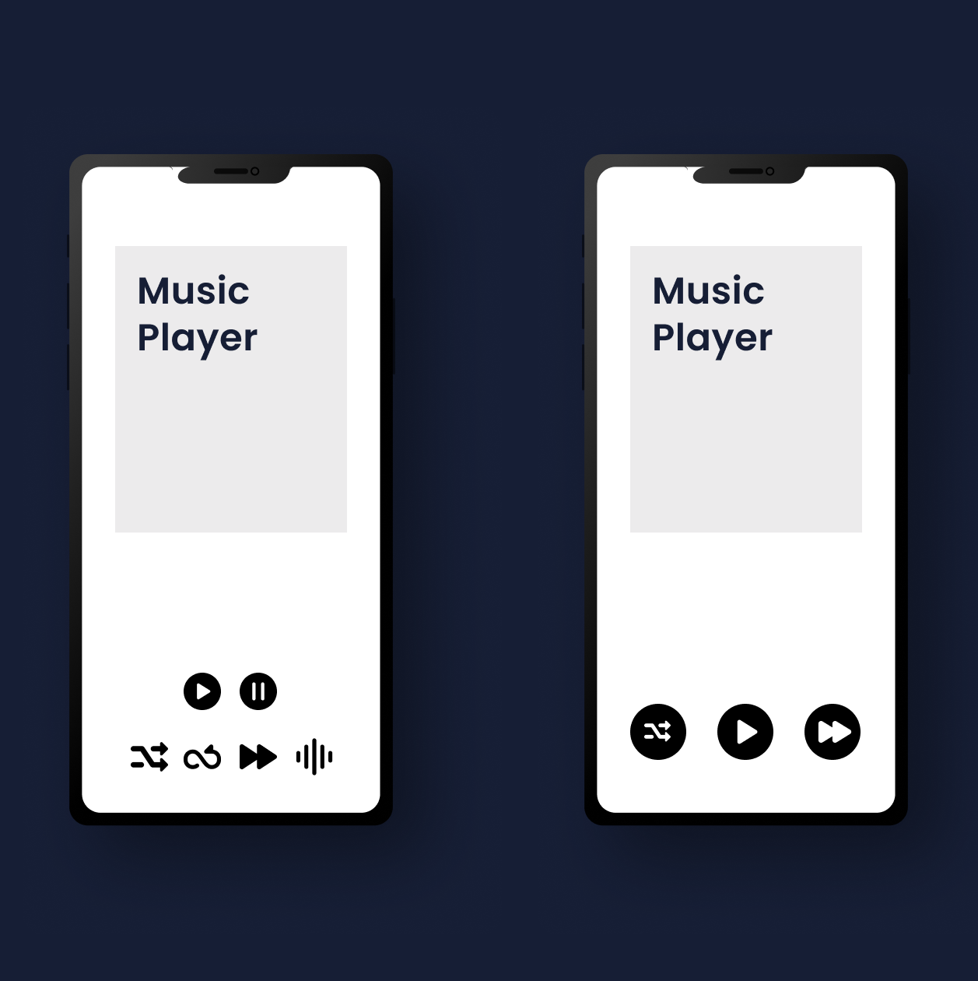
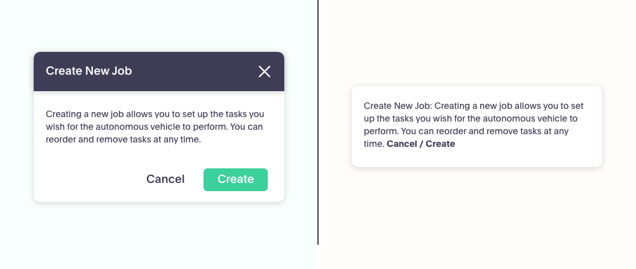
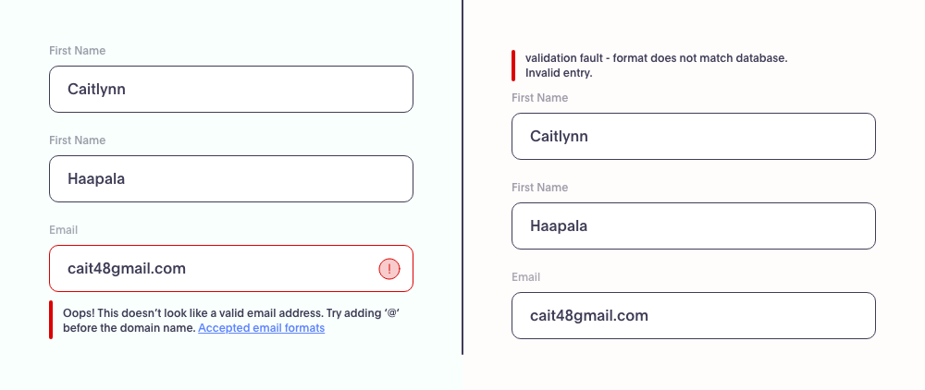
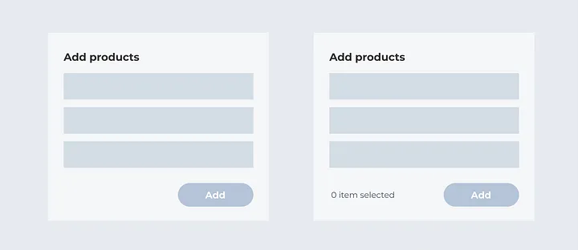
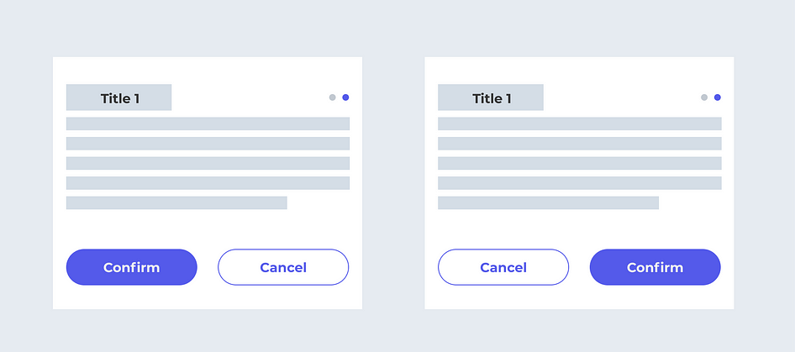

Slide 41
